Slide 1
Анализ корпуса текстов носителей, не носителей и переводных текстов
Europarl Corpus of Native, Non-native and Translated Texts - ENNTT

Slide 2
Корпус ENNTT
Project homepage: https://nlp.unibuc.ro/resources.html#ENNTT
Dataset: https://github.com/senisioi/enntt-release
“A Corpus of Native, Non-native and Translated Texts”, LREC, 2016
Natives: 116341 rows, UK and Ireland
Non-natives: 29734 rows, 25 states
Translations: 738597 rows, 25 languages

Slide 3
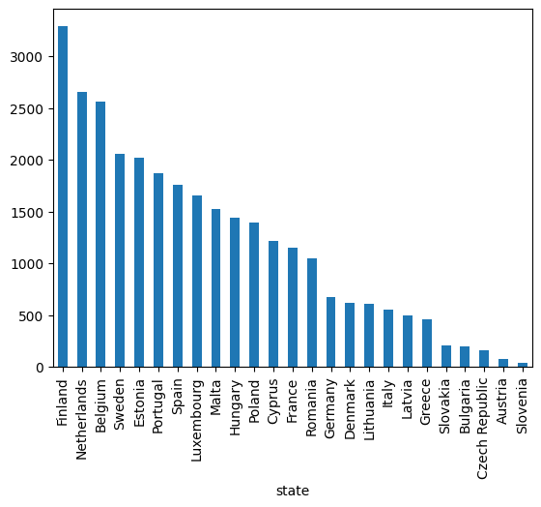
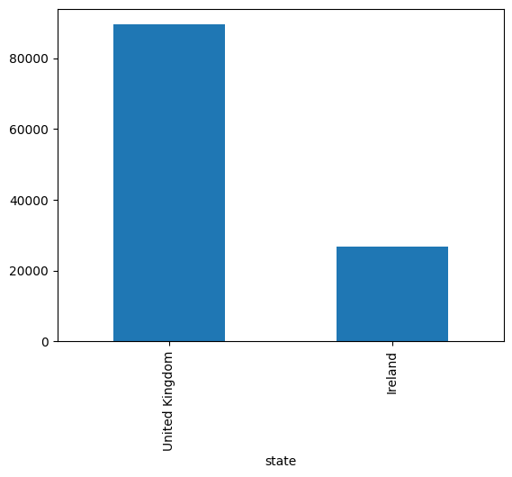

Slide 4
Инструментарий
XML
Pandas
NLTK (stopwords, bigrams, collocations, FreqDist)
Stanza (tokenize, pos, lemma)
lexical-diversity (https://github.com/kristopherkyle/lexical_diversity)
Matplotlib
WordCloud

Slide 5
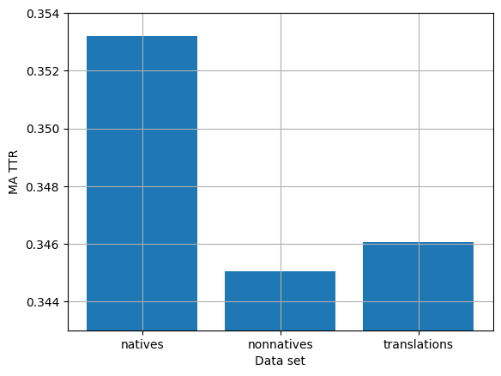
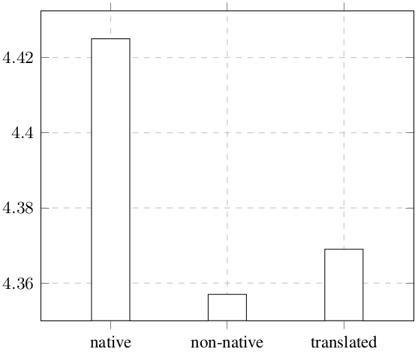
Лексическое разнообразие (TTR)

Slide 6
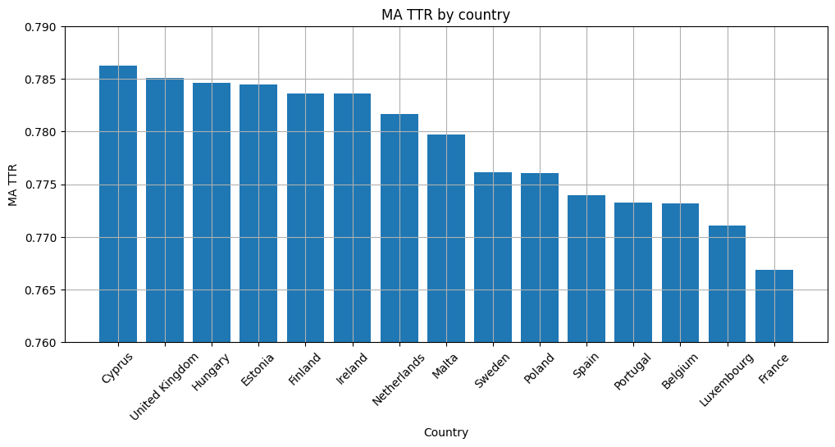

Slide 7
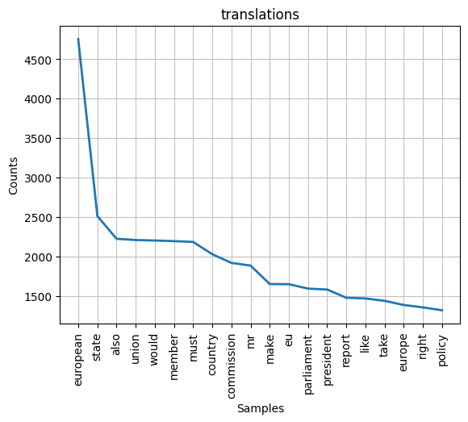
Частоты

Slide 8
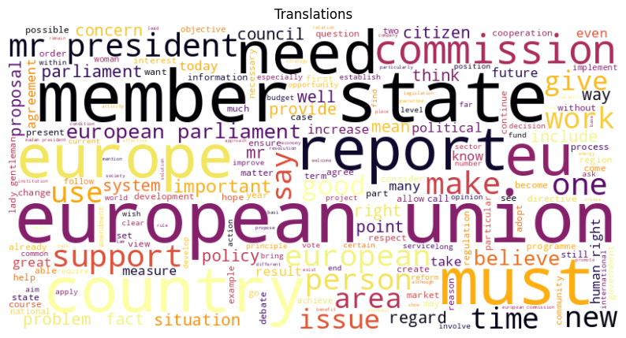

Slide 9
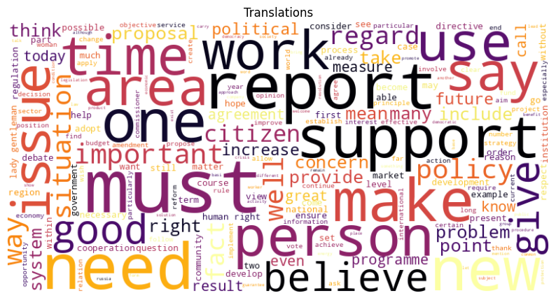

Slide 10
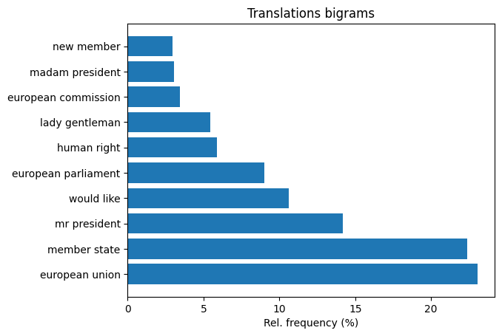

Slide 11
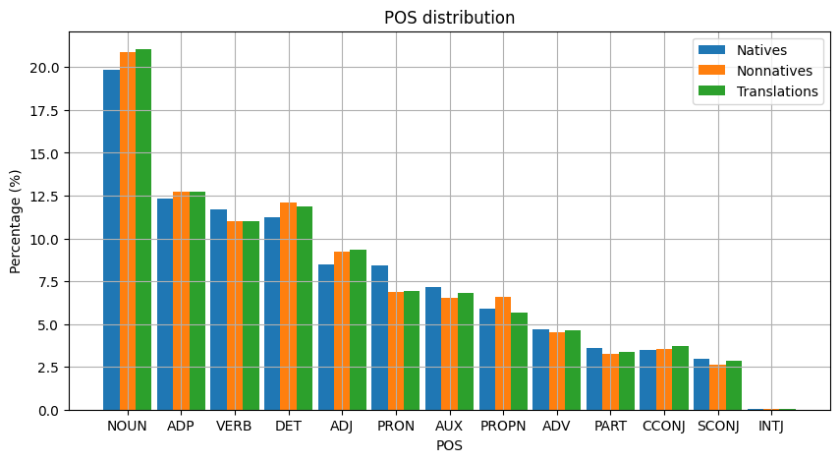
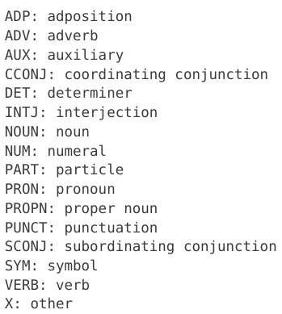

Slide 12
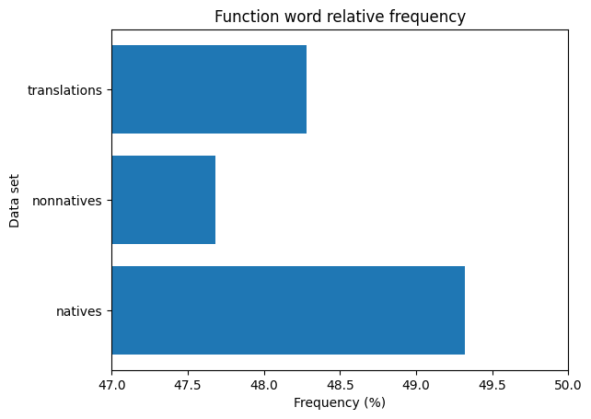

Slide 13
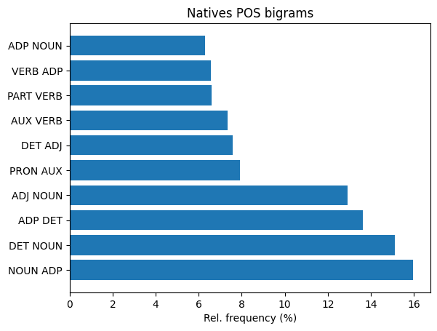

Slide 14
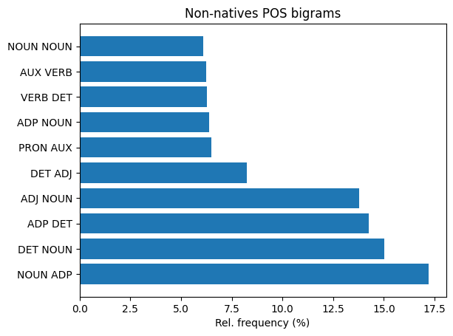

Slide 15
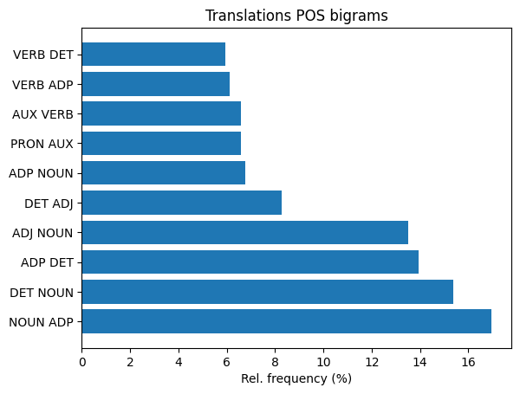

Slide 16
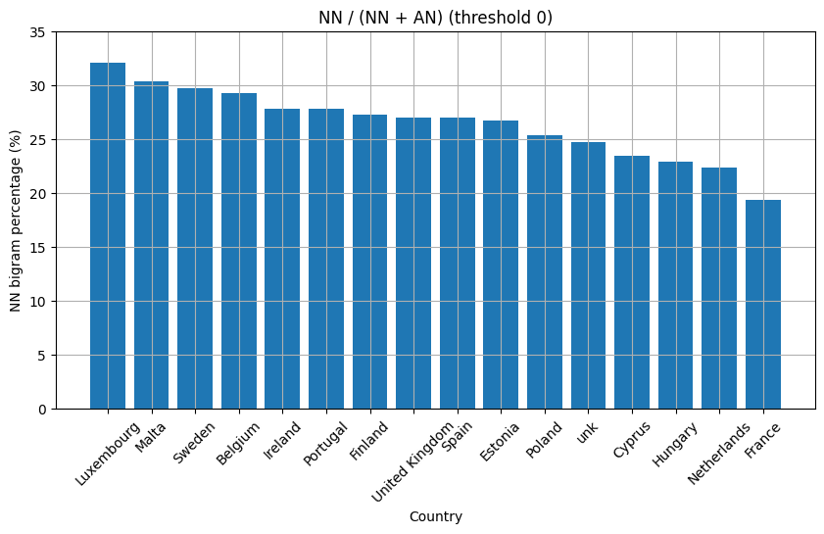

Slide 17
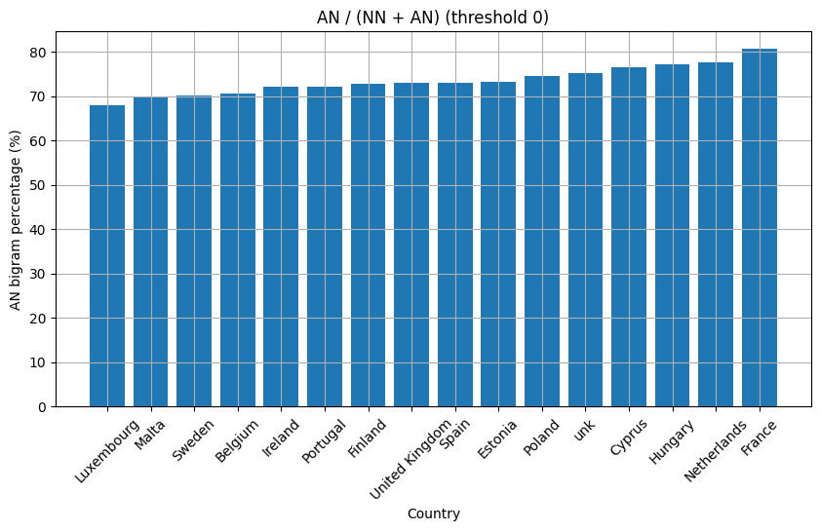

Slide 18
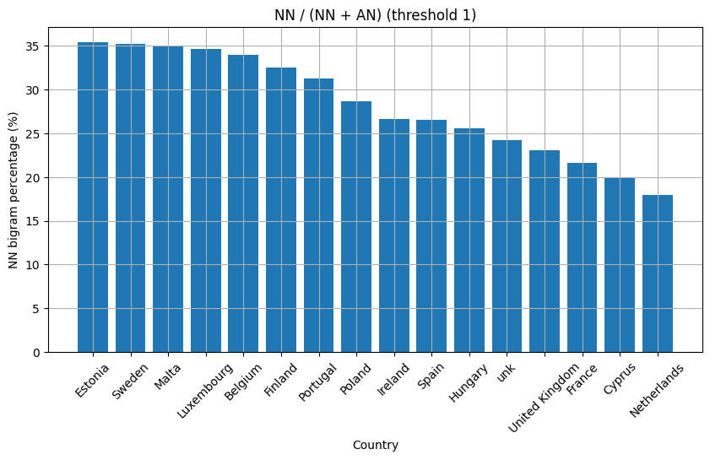

Slide 19
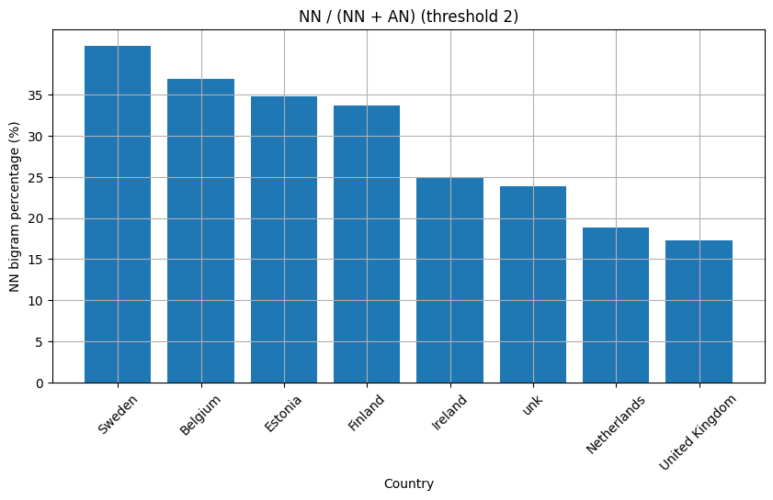

Slide 20
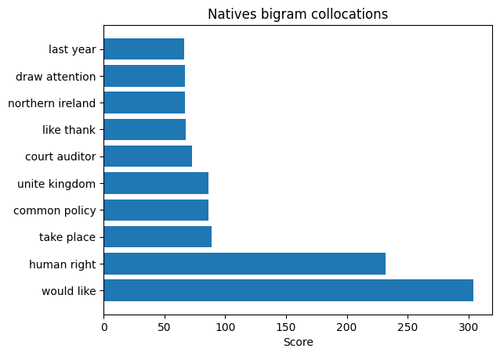
Collocations

Slide 21
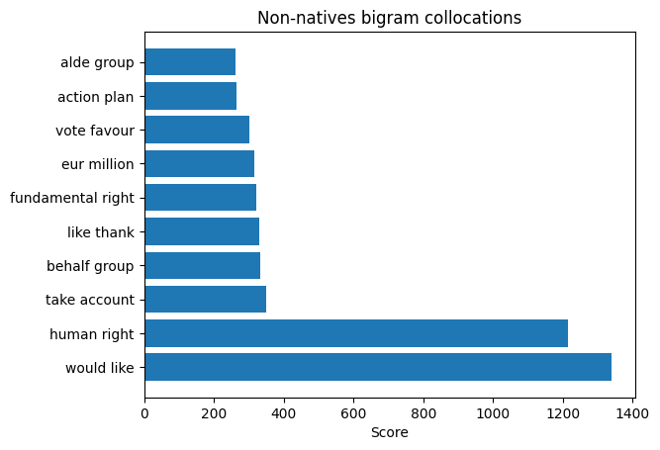
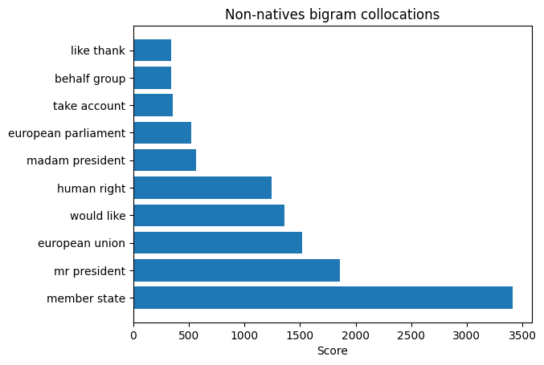

Slide 22
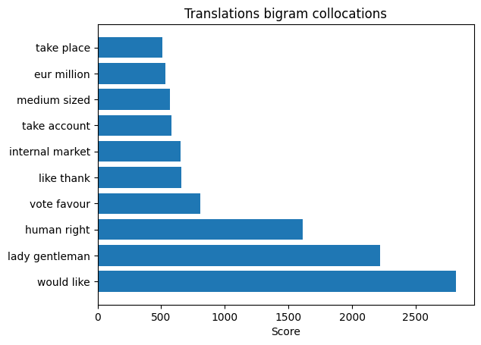

Slide 23
Спасибо за внимание!

